Slide 1
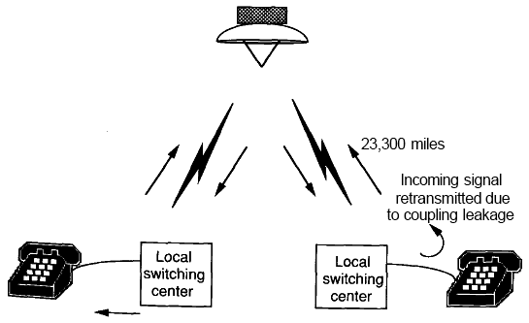
Adaline & Madaline

Slide 2
History
Bernard Widrow and Ted Hoff, in 1960, introduced the Least-Mean-Squares algorithm (delta-rule or Widrow-Hoff rule) and used it to train ADALINE(ADAptive LInear NEurons or ADAptive LINear Elements), when Neural Networks fell out of favor in the late 1960s.
  Similar to a perceptron, but using a linear activation function instead of a threshold.
MADALINE(Multiple ADALINE) used multiple ADALINE.
  Still in a single conceptual layer
  Combined their outputs in a fixed way (AND, OR, majority vote takers).
MADALINE and the delta-rule were used to eliminate echo in phone lines in the first practical application of ANNs.
  They are still used today in telecommunications.

Slide 3
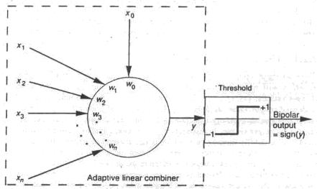
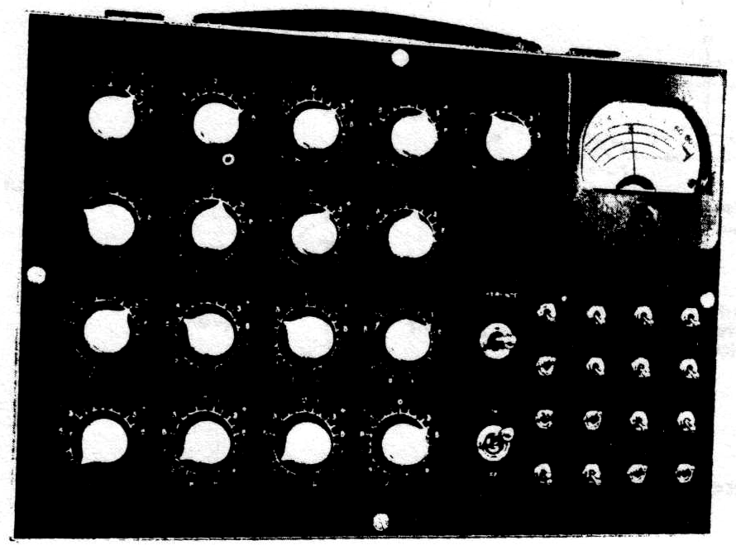
Adaline - history
An adaptive pattern classication machine (called Adaline)
  “During a training phase, crude geometric patterns are fed to the machine by setting the toggle switches in the 4x4 input switch array.
  The reference switch tells the machine whether the desired output for the particular input pattern is +1 or -1.
  The system learns something from each pattern and accordingly experiences a design change..”
  (Widrow and Hoff, 1960)

Slide 4
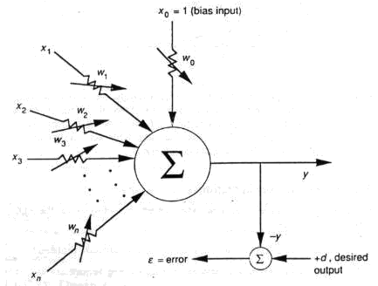
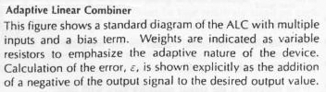
Adaline – Widrow-Hoff Learning
The learning idea is:
Define an error function that measure the performance of the weights, input, output and desired output.
Take the derivative of this function with respect to the weights, and modify the weights accordingly such that the error is decreased.
Also known as the Least Mean Square (LMS) error algorithm, the Widrow-Hoff rule, the Delta rule.

Slide 5
The Adaline Architecture
1
X₁
b
W₁
X₂
W₂
Y
….
W_{n}
X_{n}

Slide 6
The ADALINE Learning Algorithm (Fausett, 1994)
Step 0: Initialize all weights and set learning rate
w_{i} = small random values between -1.0 and 1.0
b = small random values between -1.0 and 1.0
α = 0.1 ≤ nα ≤ 1.0; where n is the number of input units.
Step 1: While stopping condition is false do Steps 2-6
Step 2: For each bipolar training pair s:t do Steps 3-5
Step 3: Set activations on input units, i = 1, …, n : x_{i} = s_{i}
Step 4: Compute net input to output units:
y_in = b + Σ x_{i} w_{i}
Step 5: Update bias and weights, i = 1, …, n :
b(new) = b(old) + α(t – y_in)
w_{i}(new) = w_{i}(old) + α(t – y_in)x_{i}
Step 6: Test for stopping condition:
If the largest weight change that occurred in Step 2 is smaller than a specific tolerance, then stop; otherwise continue.
Approximately, the adaline converges to Least Mean Squares (LMS) error:
E = (t – y_in)²

Slide 7
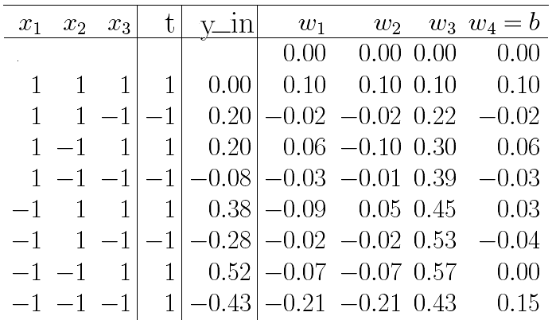
ADALINE Training Example (α = 0.1)
Epoch 1:

Slide 8
The ADALINE Classifying Algorithm (Fausett, 1994)
Step 0: Initialize all weights and set learning rate
(From Adaline training algorithm results)
Step 1: For each bipolar input vector x, do Steps 2-4
Step 2: Set activations of the input units to x
Step 3: Compute net input to output units:
y_in = b + Σ x_{i} w_{i}
Step 4: Apply the activation function (Sign Function):
1 if y_in ≥ 0
y =
-1 if y_in < 0

Slide 9
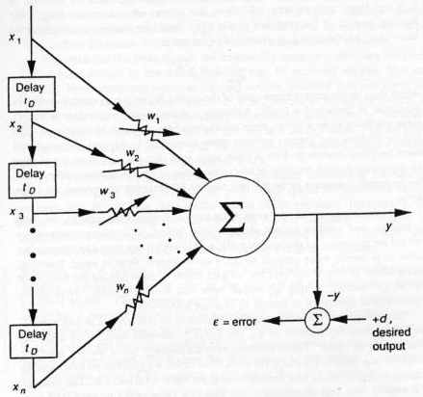
ALC arranged as Transverse Filter
ALC = Adaptive Linier Combiner
When data is initially applied, remember to wait at least nt_{D} for data to be present at all of the ALC’s inputs.

Slide 10
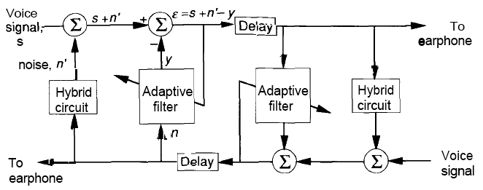
Echo Cancellation in Telephone Circuits using Transverse Filter
The phenomenon of echo in telephone conversations: You hear the words you speak into the mouthpiece a fraction of a second later in the earphone.
Telephone circuits contain devices called hybrids that are intended to isolated incoming signal from outgoing signal to avoid the echo effect.
  Unfortunately, due to cause as impedance mismatches, some outgoing signal still echoed back to the speaker.
A Transverse Filter can be used to remove the echo effect. The output of the filter y, is subtracted from the outgoing signal s + n’.

Slide 11
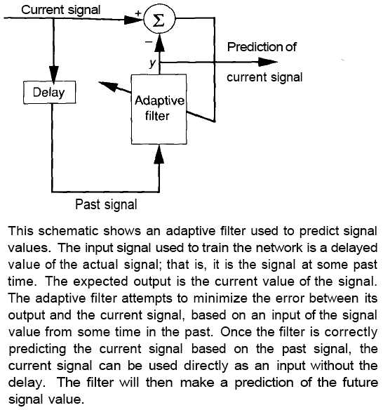
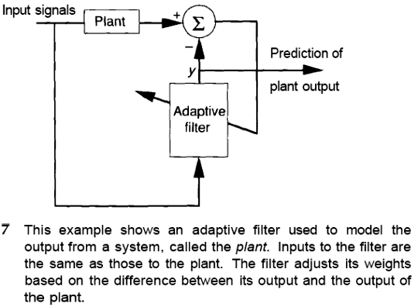
Others Aplications

Slide 12
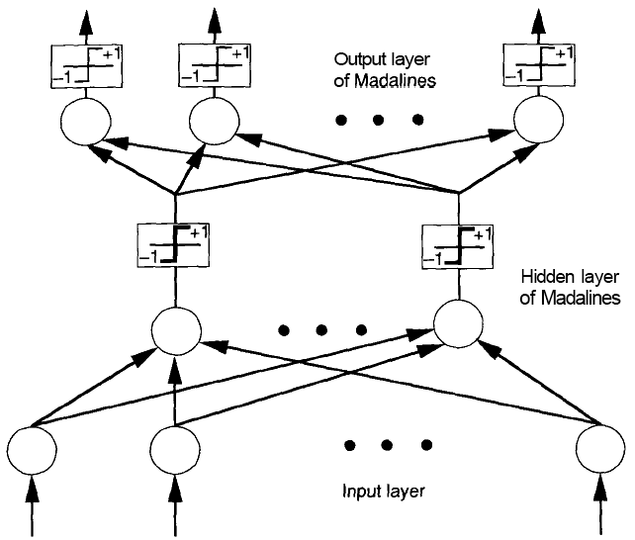
Madaline
Madaline -> Many Adalines.
Arranged in a multilayered architecture.
Can be presented with a large-dimensional input vector.
  e.g. the pixel values from raster scan.
With a proper training, the network can respond with binary +1 on one of the output nodes that is corresponds to a different category of input.
Essentially no change in the training process if several Adaline units are combined in a single-layer net.

Slide 13
Single-Layer MADALINE Learning Algorithm (Fausett, 1994)
Step 0: Initialize all weights and set learning rate
w_{ij} = small random values between -1.0 and 1.0
b = small random values between -1.0 and 1.0
α = 0.1 ≤ nα ≤ 1.0; where n is the number of input units.
Step 1: While stopping condition is false do Steps 2-6
Step 2: For each bipolar training pair s:t do Steps 3-5
Step 3: Set activations on input units: x_{i} = s_{i}
Step 4: Compute net input to output units:
y_in_{i} = b + Σ x_{i}w_{ij}
Step 5: Update bias and weights
b_{i}(new) = b_{i}(old) + α(t_{i} – y_in_{i})
w_{ij}(new) = w_{ij}(old) + α(t_{i} – y_in_{i})x_{i}
Step 6: Test for stopping condition:
If the largest weight change that occurred in Step 2 is smaller than a specific tolerance, then stop; otherwise continue.
Approximately, the adaline converges to Least Mean Squares (LMS) error:
E = (t_{i} – y_in_{i})²

Slide 14
Multi-Layer Madaline computes XOR problem
1
X₁
b₁
W₁₁
1
W₁₂
Z₁
b₃
V₁
Y
Z₂
V₂
W₂₁
X₂
W₂₂
b₂
1

Slide 15
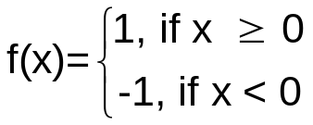
Madaline Training Algorithm (MR-I) (Fausett, 1994)
The Activation Function:
Step 0: Initialize weights:
- Weights V1, V2, b3 = 0.5
- Use small random values between -1.0 and 1.0 for ADALINE weights.
- Set learning rate α = 0.1 ≤ nα ≤ 1.0; where n is the number of input units.
Step 1: While stopping condition is false, do Step 2 – 8
Step 2: For each bipolar training pair S:T, do Step 3 – 7
Step 3: Set activations on input units:
X_{i} = S_{i}
Step 4: Compute net input to each hidden ADALINE unit:
z_in₁ = b₁ + X₁W₁₁ + X₂W₂₁
z_in₂ = b₂ + X₁W₁₂ + X₂W₂₂
Step 5: Determine output of each hidden ADALINE unit:
Z₁ = f(z_in₁) ; Z₂ = f(z_in₂)
Step 6: Determine output of net:
y_in = b₃ + Z₁V₁ + Z₂V₂ ; Y = f(y_in)

Slide 16
Madaline Training Algorithm (MR-I)
Step 7: Determine error and update weight:
If T = Y (no error) Then no weight updates are performed
Otherwise:
If T = 1 Then update weights on Z_{J}, the unit whose net input is closest to 0,
b_{J}(new) = b_{J}(old) + α(1 – z_in_{J})
W_{iJ}(new) = W_{iJ}(old) + α(1 – z_in_{J})X_{i}
If T = -1 Then update weights on all units Z_{K} that have positive net input
b_{K}(new) = b_{K}(old) + α(-1 – z_in_{K})
W_{iK}(new) = W_{iK}(old) + α(-1 – z_in_{K})X_{i}
Step 8: Test stopping condition
If weight changes have stopped (or error reached an acceptable value, or if a specified maximum number iteration (epoch) have been performed, then stop; otherwise continue.

Slide 17
Madaline Training example: XOR
Training pattern:
X₁ X₂ T
1 1 -1 (1)
1 -1 1 (2)
-1 1 1 (3)
-1 -1 -1 (4)
Step 0: The Weight into Z₁ and Z₂ are small random value.
The learning rate, α = 0.5
Weight into Z₁ Weight into Z₂ Weight into Y
W₁₁ = 0.05 W₁₂ = 0.1 V₁ = 0.5
W₂₁ = 0.2 W₂₂ = 0.2 V₂ = 0.5
b₁ = 0.3 b₂ = 0.15 b₃ = 0.5
Step 1: Begin Training
Step 2: For the 1st training pair (1,1) = -1
  Step 3: x₁ = 1, x₂ = 1

Slide 18
Madaline Training example: XOR
Step 4: z_in₁ = 0.3 + 1 * 0.05 + 1 * 0.2 = 0.55
z_in₂ = 0.15 + 1 * 0.1 + 1 * 0.2 = 0.45
Step 5: Z₁ = f(z_in₁) = 1; Z₂ = f(z_in₂) = 1
Step 6: y_in = 0.5 + 1 * 0.5 + 1 * 0.5 = 1.5
Y = f(y_in) = 1
Step 7: T = -1 ; Y = 1 ⇒ T ≠ Y (Error Occurred)
If T = -1, update all weight that have positive input
b₁(new) = b₁(old) + α(-1 – z_in₁)
= 0.3 + 0.5 * (-1 – 0.55) = -0.475
W₁₁(new) = W₁₁(old) + α(-1 – z_in₁)X₁
= 0.05 + 0.5 * (-1 – 0.55) * 1 = -0.725
W₂₁(new) = W₂₁(old) + α(-1 – z_in₁)X₂
= 0.2 + 0.5 * (-1 – 0.55) * 1 = -0.575
b₂(new) = b₂(old) + α(-1 – z_in₂) = -0.575
W₁₂(new) = W₁₂(old) + α(-1 – z_in₂)X₁ = -0.625
W₂₂(new) = W₂₂(old) + α(-1 – z_in₂)X₂ = -0.525
Step 8: Back to Step 2 for 2nd training pair (1, -1) = 1

Slide 19
Final weights after 4 epochs of training
1
X₁
-0.99
-0.73
1
Z₁
0.5
1.27
0.5
Y
Z₂
0.5
1.53
X₂
-1.33
-1.09
1

Slide 20
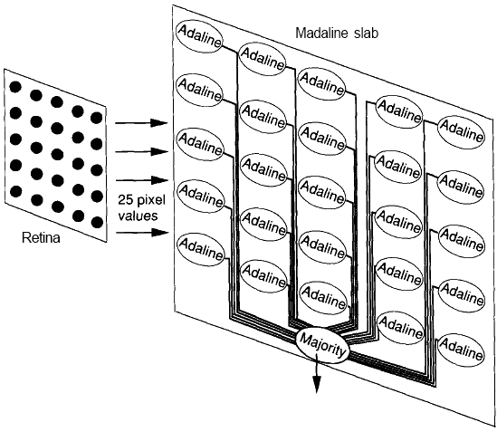
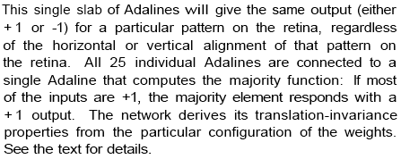
Madaline Slab
The retina is a 5x5 pixel array on which bit mapped representation of pattern, such as the letter of alphabet.
A slab does not communicate with other on network.
Each Adaline receives the identical 25 inputs from retina and compute them as usual.
The majority node computes a binary output based on the outputs of the majority of the Adalines connecting to it.
The weight on the 25 Adalines share a unique relationship.

Slide 21
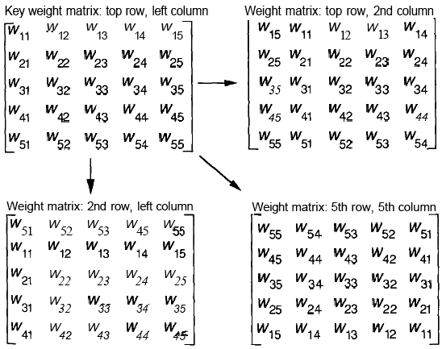
Key Weight Matrix of Madaline Slab
Each key weight matrix in first Adaline unit (top row, left column) are randomly chosen.
Then, the Adaline unit to the right of the first Adaline has identical set of weight values, but circular-translated one pixel to the right.
Similary, the unit below the first unit also has identical weights, but circular-translated one pixel down.
This translation continues across each row and down each column in a similar manner.
The weight matrix in the upper left is the key weight matriks. All other weight matrices on the slab are derived from this matriks.

Slide 22
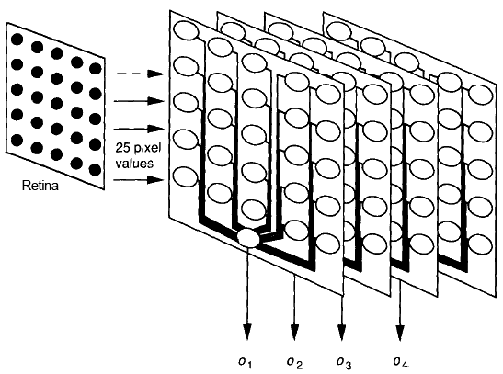
How to overcome the limitation of only two possible classes?
A Slab is capable of dividing hyperspace into two region only.
To overcome it, the retina can be connected to multiple Slabs.
Each Slab having different key weight matrices, that are generated randomly.
Given the binary nature of the output of each slab, a system of n Slabs could differentiate 2^{n} different pattern class.
No need to train the nodes in the usual sense.
If you pick a random key weight matrix for a slab and find that two inputs give same output pattern, you can simply pick a random different key weight matrix.

Slide 23
Latihan dan Proyek kecil
Latihan di kelas: point max. 16
Selesaikan contoh training madaline untuk XOR problem sampai dengan 2 epoch. Berapa semua weight yang ada setelah epoch 2 berakhir ?
Proyek Kecil dikumpulkan 3 minggu: Max point 20
Buat program Madaline Slab untuk mengenali:
- Pattern 5 Gambar Angka sembarang => kelompok genap
- Pattern 5 Gambar Huruf sembarang => kelompok gasal

